Slide 1


I2P-2
12306
beat the monster

Slide 2

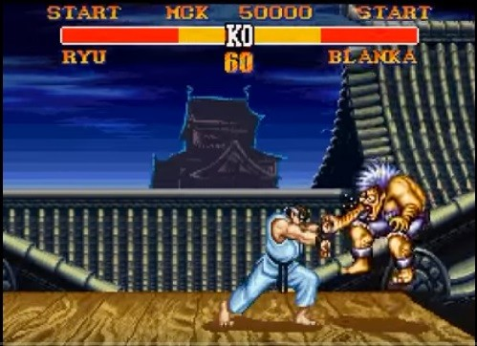


You are playing a game.
The goal of this game is to kill the monster when you are still alive (HP > 0).
The monster is dead if and only if its HP <= 0.
Description

Slide 3
Description
This game consists of rounds, and you go first in each round. In each round,
you have three options to do:
ATTACK. This will deduct the monster's HP. If your damage point is p, then you can deduct the monster's HP by p.
HEAL. You can recover some of your HP, but it can't exceed your max HP.
Level-up. Level-up might enhance or deduct the effect of attacking and healing. If you have reached max level, taking this action makes no effect.不會改動你的血量!!!
the monster will attack you once with a fixed damage point.
You start the game with full HP and level 1. What is the minimun number of rounds you need to kill the monster?

Slide 4
Input
First line contains 4 numbers:
L = max level
HP = your max HP
MHP = monster's HP in the beginning of game
MDMG = monster's damage point
Each of the next L lines describes each level i. Each line i consists of two numbers:
DMG = your damage point when you use ATTACK at level i
HL = amount of HP you can recover when you use HEAL at level i
Input/Output
Output
Print a single integer, denoting the mininum number of steps you need to kill the monster.
If you are unable to beat the monster, print -1.

Slide 5
Input
3 10 5 2 (your max level, your max HP, monster HP, monster damage point)
1 1 (level 1 damage point, amount of heal)
2 2 (level 2 damage point, amount of heal)
3 3 (level 3 damage point, amount of heal)
Output
Example
4
Round | Your hp | Monster hp | Level
0 | 10 | 5 | 1
Round | Your hp | Monster hp | Level
0 | 10 | 5 | 1
1 | 8 | 5 | 2
2 | 6 | 3 | 2
3 | 4 | 1 | 2
4 | 2(或可為4) | -1 | 2
Round | Your hp | Monster hp | Level
0 | 10 | 5 | 1
1 | 8 | 5 | 2
Round | Your hp | Monster hp | Level
0 | 10 | 5 | 1
1 | 8 | 5 | 2
2 | 6 | 3 | 2
Round | Your hp | Monster hp | Level
0 | 10 | 5 | 1
1 | 8 | 5 | 2
2 | 6 | 3 | 2
3 | 4 | 1 | 2
LV UP
ATK
ATK
ATK

Slide 6

Idea
Since level up may not be better all the time, so we can’t have a specific way to get the answer by doing something greedy (or heuristic(還記得AI的heuristic計算方式嗎?)).
So the best way is to try all possible permutations of doing attack / level up / heal.
And, since you want the minimum number of steps, you can use breadth-first search (BFS).
Let’s see another example with BFS.

Slide 7
BFS
1/5/8
Input:
2 5 8 2
2 4
3 0
LV UP
ATK
HEAL
2/3/8
1/3/6
1/3/8
LV UP
HEAL
ATK
…
LV UP
ATK
…
ATK
…
LV max
Cannot level up
x
2/1/5
2/1/6
1/1/4
1/3/6
1/1/6
…
…
HEAL
…
…
…
ATK
ATK
LV UP
ATK
ATK
2/-1/2
2/-1/3
2/-1/4
1/-1/2
1/3/4
1/1/4
Died
…
ATK
…
…
1/1/2
***State: Level / your hp / monster hp
Note also that, in each round, you go first!!!
Note the HEAL operation.
…
…
ATK
1/1/0
You win, since you attack first.

Slide 8
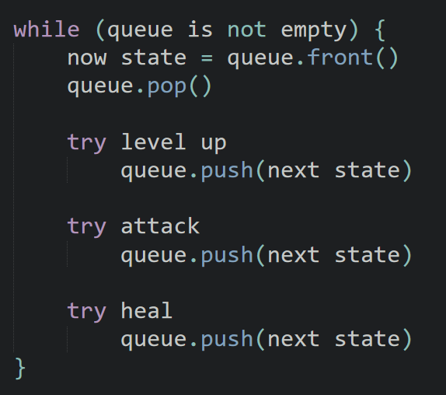
BFS
We can use a data structure: queue.

Slide 9
Optimize
However, if you simply use BFS to enumerate(enum，窮舉) all permutations, you will probably get TLE.
Since there are too many ways of permutation.
So is there any way to optimize?

Slide 10
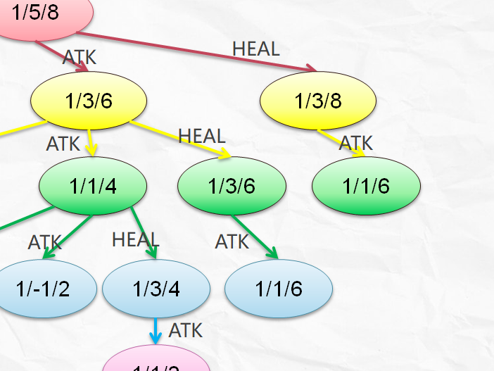
Optimize
Yes, as you can see, different permutations can arrive at a same state (狀態). You don’t really need a same state twice. We only need the shortest one.
我們不需要重複的State，因為這樣會繞不出迴圈，而且純粹浪費資源。

Slide 11

Optimize
So you can simply use an array like this.
All with value false first.
vis[x][y][z] == false represents (level = x, hp = y, monster hp = z) has not been pushed into your queue yet.
vis[x][y][z] == true represents (level = x, hp = y, monster hp = z) has already been visited.

Slide 12
Data structures
struct State {
int lv, hp, mhp;
int dist;
State(int lv, int hp, int mhp, int dist = 0): lv(lv), hp(hp), mhp(mhp), dist(dist) {}
};
bool vis[20][310][410];
State
Rounds

Slide 13
The structure of main()
int main() {
//read the input
int lv, hp, mhp, mdmg;//lv: 我的最高可達level
//hp:我的最高可達血量
//mhp:敵人最高可達血量
//mdmg: 敵人每回合的攻擊大小
int dmg[20], hl[20];
cin >> lv >> hp >> mhp >> mdmg;
for (int i = 1; i <= lv; i++)
cin >> dmg[i] >> hl[i];
queue<State> q;//the queue for BFS
q.push(State(1, hp, mhp));//the initial state
while (!q.empty()) {
State s = q.front();
if (!s.mhp) //因為敵人不可能有負血(後方code設計)，
所以敵人死亡時血量一定為0。
break;
q.pop();
//Calculate the next states
// level up
???
// attack
???
// heal
???
}//end while
if (q.empty())
cout << -1 << endl;
else
cout << q.front().dist << endl;
return 0;
}

Slide 14
The next state when applying “level up”
You should avoid: “level over max level” and avoid your hp going to negative value, or you might get Runtime Error since you put negative value in array.
if (s.lv < lv(常數，永遠不動，指我的最高level) && s.hp - mdmg > 0) {
State t(s.lv + 1, s.hp - mdmg, s.mhp, s.dist + 1);
if (!vis[t.lv][t.hp][t.mhp]) {
vis[t.lv][t.hp][t.mhp] = true;
q.push(t);
}
}//我要判斷可不可升級的依據，就是他目前的level一定要比我小。Ex: 他是4，而level_max是5，就可升。如果他5，level_max=5，就不可升。
//如果升級，在那之後就一定會吃一頓揍，我要確保我吃揍之後仍然是存活狀態，否則就不用排進去queue裡面。//因為我關心的是可以造成敵人死亡的路徑模式，所以我絕對不可以死。我死了我就不能判斷敵人哪時候會輸了，因為敵人一定贏，而這並不是題目所要得到的。

Slide 15
The next state when applying “attack”
You should avoid your hp going to negative value, or you might get Runtime Error.
However, you need to attack the monster if the monster is confirmed to be dead, since you attack first.
if (s.hp - mdmg > 0 || s.mhp - dmg[s.lv] <= 0) {
State t(s.lv, s.hp - mdmg, max(0, s.mhp - dmg[s.lv]), s.dist + 1);
if (!vis[t.lv][t.hp][t.mhp]) {
vis[t.lv][t.hp][t.mhp] = true;
q.push(t);
}
}
//第一個判斷是指，我如果打他，他沒死的話，我一定會吃一頓揍，我要確保吃揍之後我仍然存活。
//第二個判斷是指，如果我打他他就一定死的話，我就直接打爆他了。我根本不用害怕之後吃揍，因為是我先出手，所以一定是他先死。
藍色部分: 因為我前面的main裡的for是設計敵人在死亡時的血量一定是0，所以如果是負的話，要改成0。更重要地，因為我有bool visited[][][]，所以如果你敵人死亡時是負血量的話，會戳到根本根本不存在的記憶體位置導致RE，所以勢必得弄成>=0。
黑色部分: 我在攻擊之後，一定會吃一頓揍，所以這是在計算吃揍之後的我的血量。照理講如果敵人直接被我打爆的話，我是不用扣血量的，而且照理講，這個數字也要符合我在藍色部分所寫的紅色字的內容，所以這應該是助教code有疏漏。

Slide 16
The next state when applying “heal”
You should avoid your hp going to negative value, or you might get Runtime Error
if (hp > mdmg && hl[s.lv] > mdmg) {
State t(s.lv, min(hp, s.hp + hl[s.lv]) – mdmg(這個黑色同時也是藍色), s.mhp, s.dist + 1);
if (!vis[t.lv][t.hp][t.mhp]) {
vis[t.lv][t.hp][t.mhp] = true;
q.push(t);
}
}

Slide 17
Time complexity
Note:
L <= 15
HP <= 300
MHP <= 400
So you will only have at most 15 * 300 * 400 different states, and each state will only be pushed into and popped from queue once.
And for each state, you only have 3 types of options to do.
That is, your amount of transitions (轉移數) is 3 for each state.
So your Time Complexity will be O(15 * 300 * 400 * 3).

Slide 18
Code:
https://gist.github.com/justin0u0/a639f7de49acb7ba9da12c3d7a92cf25

